Slide 1
IBM University Engagement Project Submission
“Exploring the Power of Agentic AI with IBM Granite and IBM Bob”

Slide 2

Project Tile – Career Compass
Domain of Project – Education
Student Name | Recent Passport Photo | Email ID | Mobile number [WhatsApp]
Pallavi Patluri |  | pallavi16114421@gmail.com | 801398055

Slide 3
Problem Statement
Problem Statement – Agentic Career Counseling Companion
The Challenge – Students often struggle to make informed career decisions due to fragmented access to guidance, limited self-awareness of academic strengths, and rapidly evolving industry landscapes. Traditional counseling methods lack personalization and scalability, leading to missed opportunities and career mismatches. The challenge is to develop an intelligent, autonomous agent that continuously monitors student performance, evolving interests, and real-time labor market trends to deliver tailored career pathway suggestions. This would empower students to make confident, future-ready decisions with minimal dependency on manual intervention.
Technology – Use of IBM Cloud Lite services / IBM Granite is mandatory.

Slide 4
Proposed Solution
Career Compass is an agentic career counseling companion designed to provide personalized, actionable career guidance to students.
The system analyzes academic performance, skills, interests, projects, and career goals to identify suitable career pathways.
It provides:
Personalized Career Recommendations
Skill-Gap Analysis
Learning Roadmaps
Project Recommendations
Career Readiness Assessment
Conversational & Context-Aware Guidance
The agent continuously uses the student's profile and career requirements to generate relevant next steps, helping students move from career confusion to a clear, future-ready career pathway.
IBM Technology
IBM Granite + IBM Cloud Lite

Slide 5
Technology Used
IBM Granite – Large Language Model used for natural language understanding, reasoning, and personalized career guidance.
IBM Cloud Lite – Cloud platform used to support the development and deployment of the Career Compass solution.
IBM Bob – AI-powered development assistant used to accelerate application development and implementation.
RAG (Retrieval-Augmented Generation) – Used to ground career recommendations using relevant information from the Career Compass knowledge base.
watsonx.ai – IBM AI platform used for working with foundation models and AI-powered application development.
Vector Database – Used to store and retrieve career, skill, and learning information efficiently for contextual recommendations.
Python & Flask – Used for backend development, agent logic, API handling, and communication between the frontend and the career guidance engine.
HTML, CSS & JavaScript – Used to create the interactive Career Compass frontend.

Slide 6
Required Files created using IBM bob
Frontend: HTML, CSS, JavaScript
Backend: Python, Flask
Agent: agent.py, companion_agent.py, planner.py, memory.py
Specialized Tools: Career, Skill, Roadmap, Learning, Project & Market Tools
Knowledge Base: Career Roles, Skills, Learning Resources & Job Market JSON files
Data: Sample Student Profiles
Configuration: requirements.txt, config.py, README.md, .gitignore

Slide 7
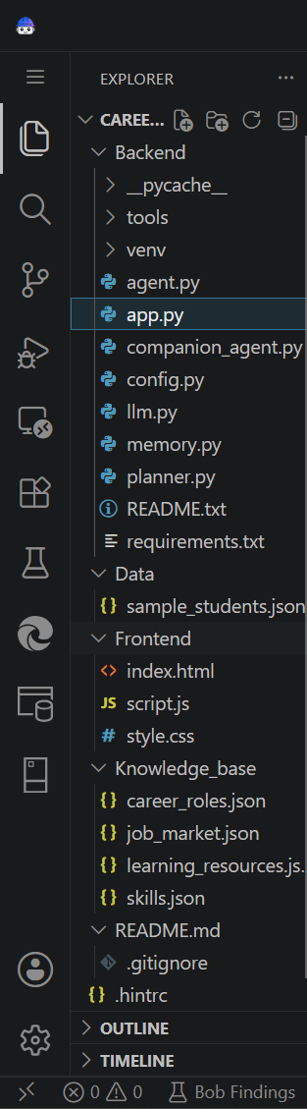
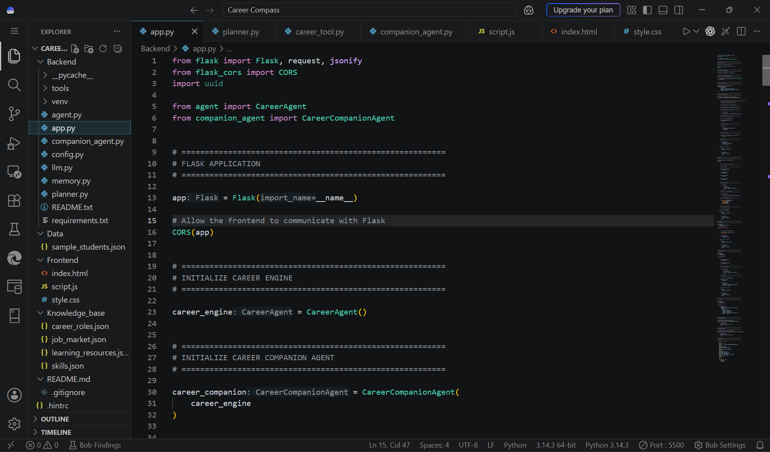

Slide 8
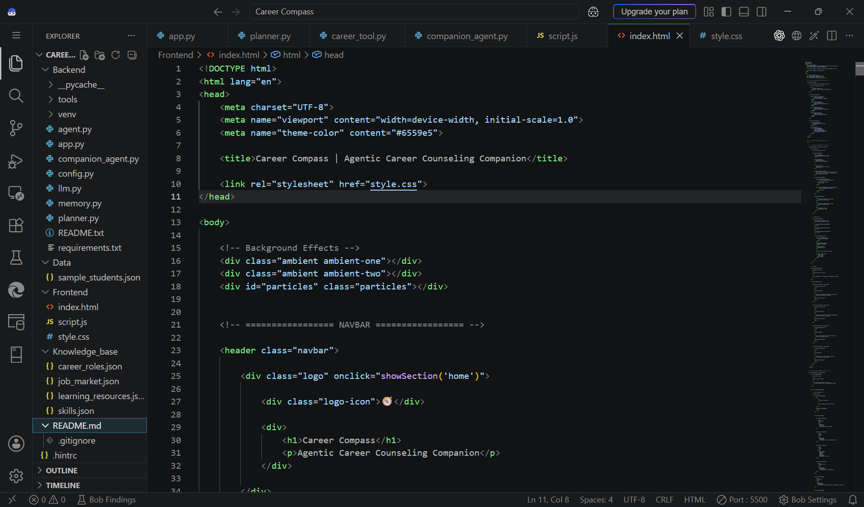
IBM Bob Screenshots

Slide 9
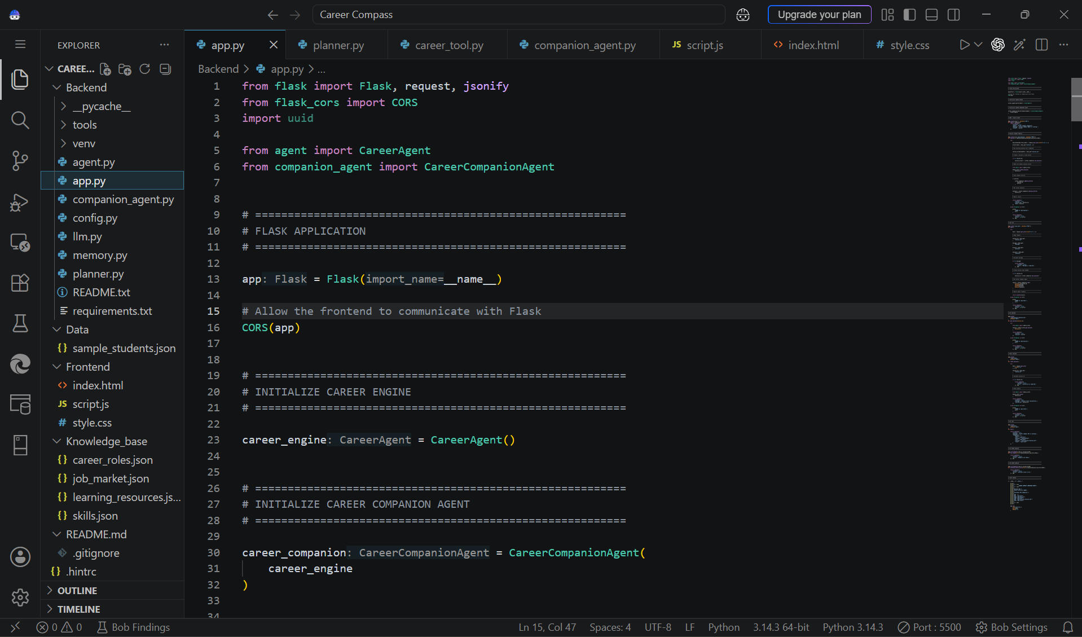
IBM Bob Screenshots

Slide 10
IBM Bob Screenshots

Slide 11
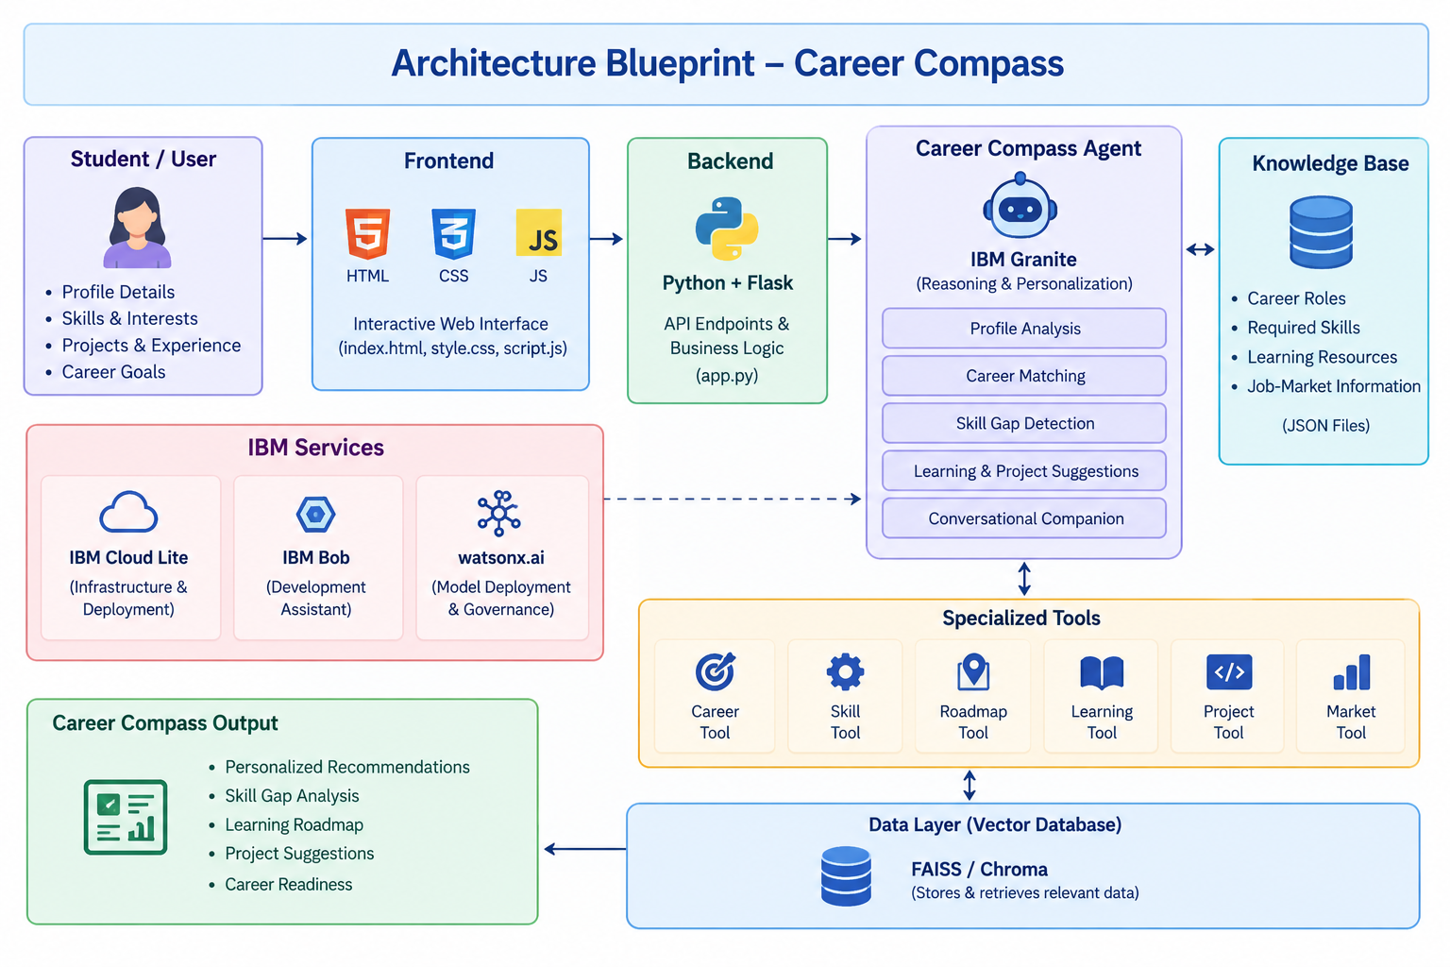
Architecture blueprint for IBM bob

Slide 12
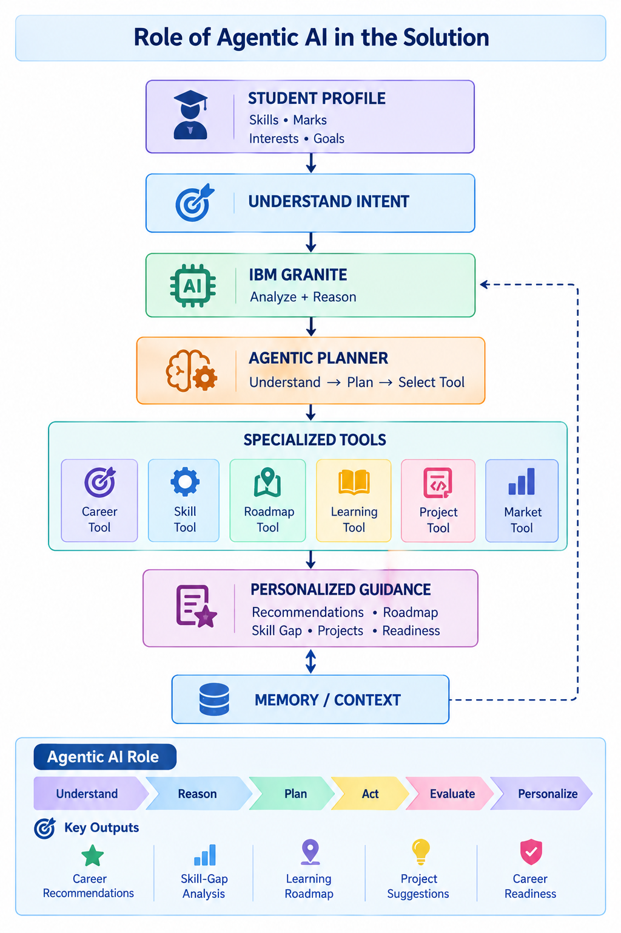
Role of Agentic AI in the solution
1. Understand Student
Analyzes the student's academic performance, skills, interests, projects, and career goals.
⬇️
2. Identify Career Intent
Determines what the student needs — career discovery, comparison, skill-gap analysis, learning guidance, projects, or readiness assessment.
⬇️
3. Analyze & Reason
The Career Compass Agent evaluates the student's profile against career requirements using IBM Granite and the career knowledge base.
⬇️
4. Select & Execute Tools
The agent dynamically selects the appropriate specialized tool:
Career Tool → Skill Tool → Roadmap Tool → Learning Tool → Project Tool → Market Tool
⬇️
5. Generate Personalized Guidance
Combines the analysis and retrieved knowledge to provide personalized career recommendations and actionable next steps.
⬇️
6. Maintain Context
Uses conversation memory to understand follow-up questions and provide context-aware guidance throughout the interaction.

Slide 13
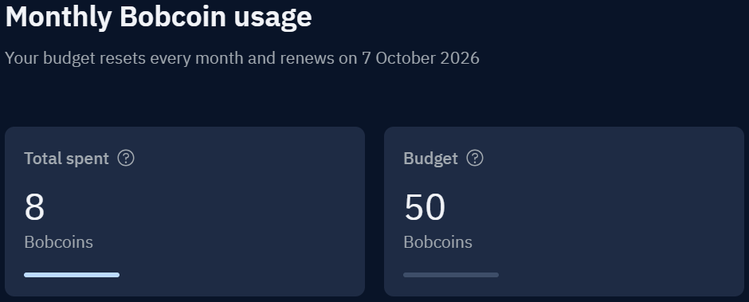
Token Usage

Slide 14
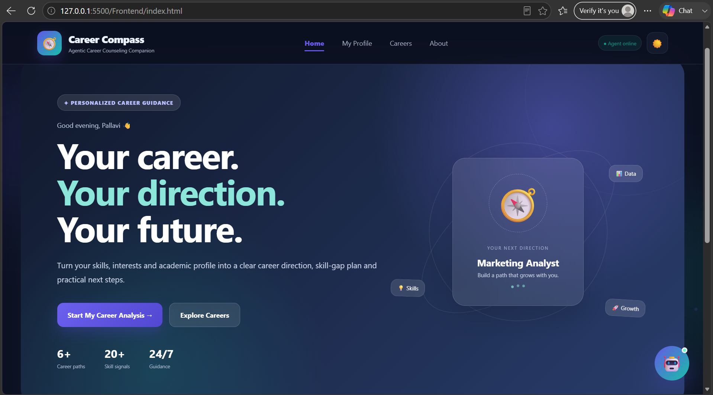
Project Output Screenshot

Slide 15
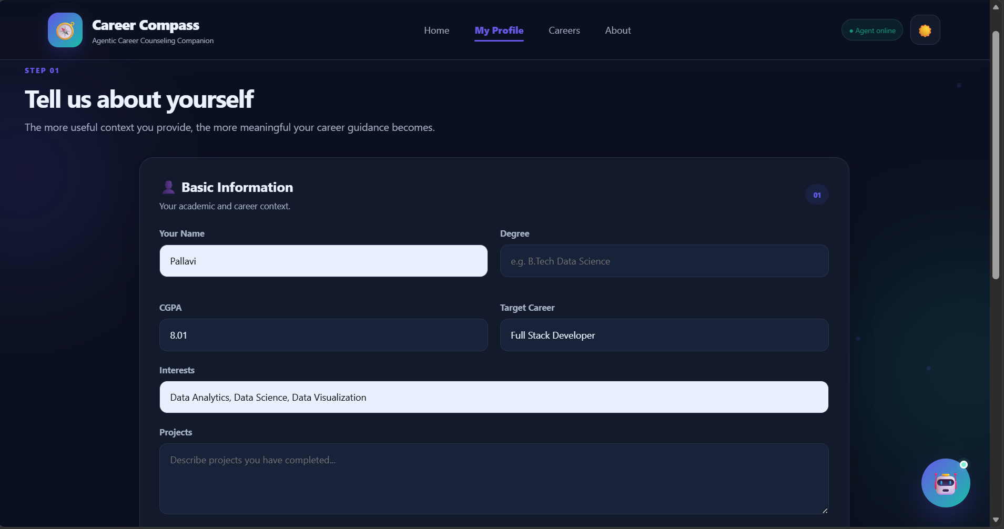

Slide 16
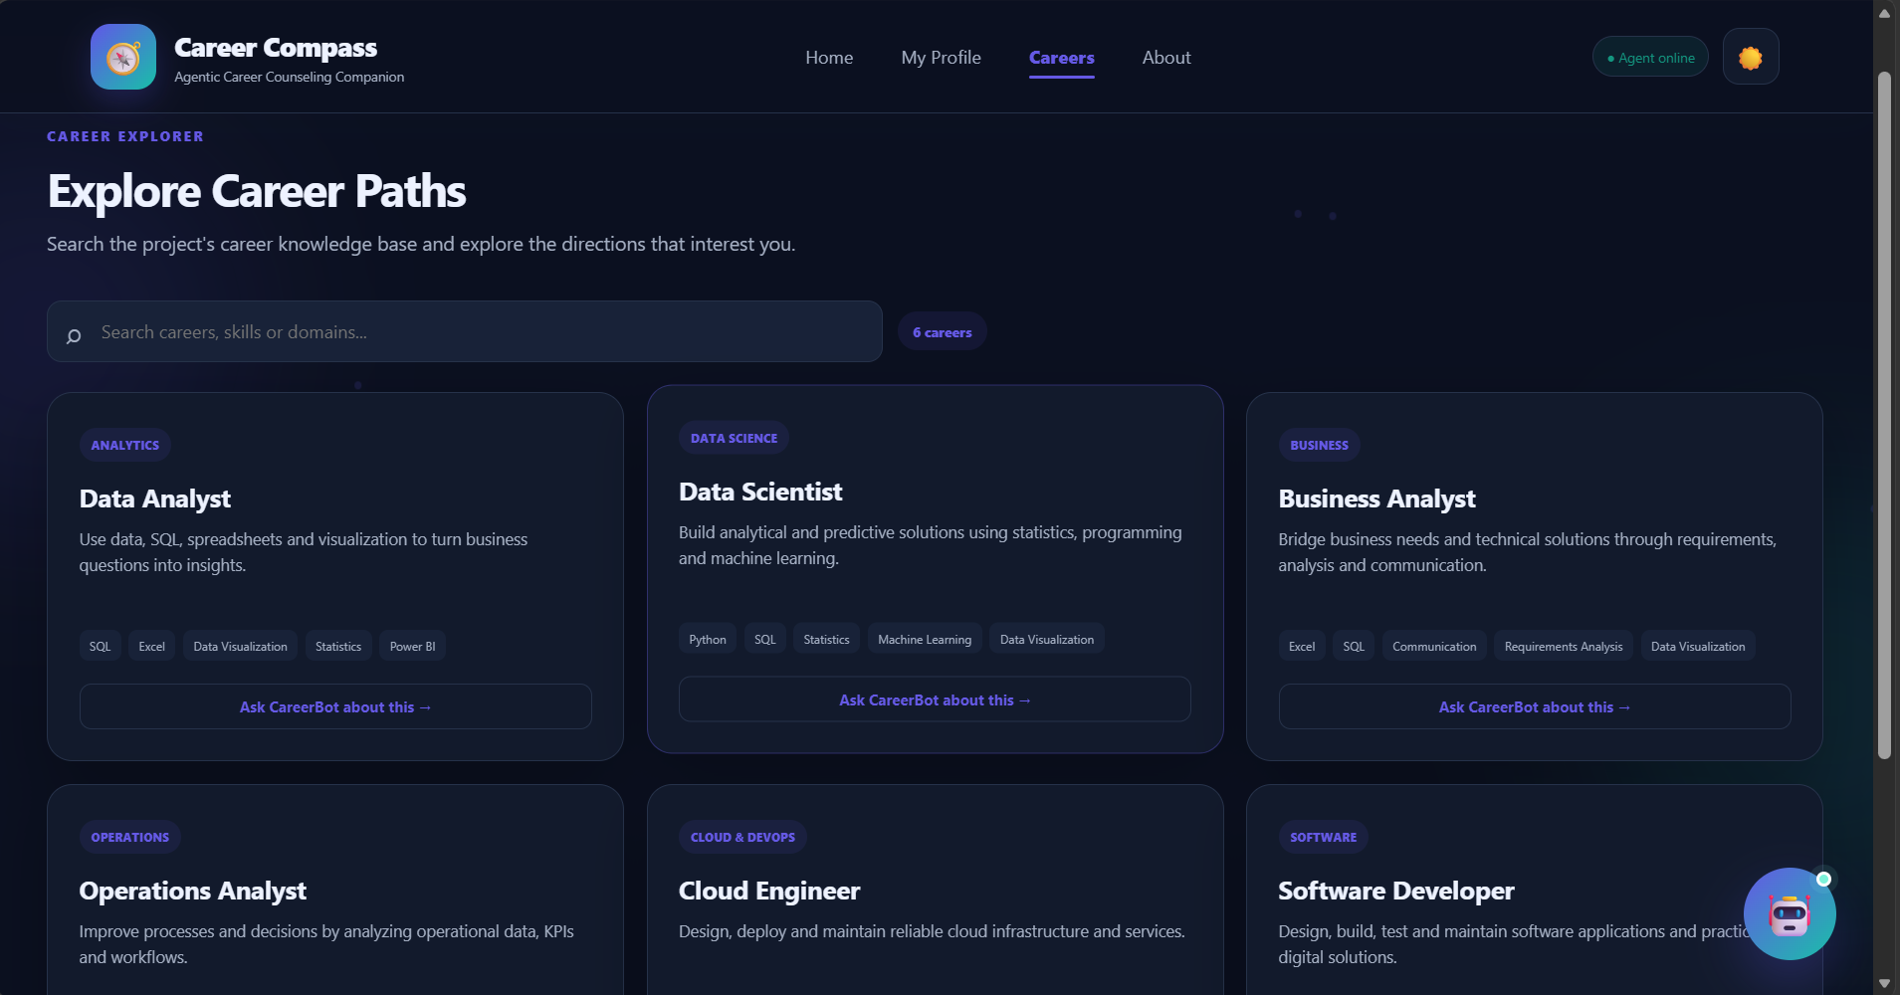

Slide 17
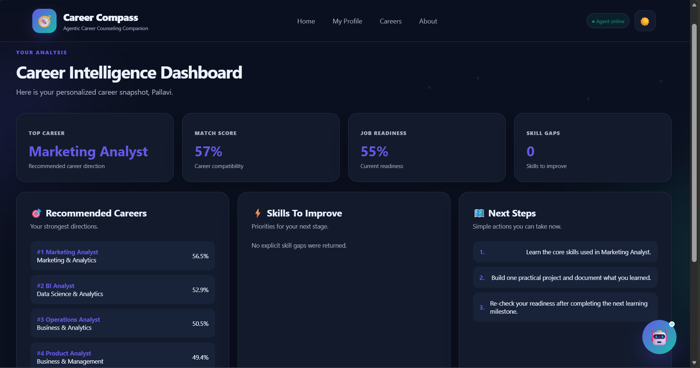

Slide 18
Novelty and Uniqueness
Personalized Career Intelligence
Unlike generic career recommendation systems, Career Compass considers the student's skills, academic performance, interests, projects, and goals to provide individualized career guidance.
Agentic Decision-Making
The system doesn't simply return predefined answers. The Career Compass Agent understands the user's intent, plans the task, selects the appropriate tool, and generates a contextual response.
Specialized Career Tools
A single companion integrates multiple capabilities — Career Matching, Skill-Gap Analysis, Roadmap Generation, Learning Recommendations, Project Suggestions, and Market Guidance.
Context-Aware Conversation
The agent maintains conversation memory, allowing students to ask follow-up questions without repeatedly providing their profile information.
From Recommendation to Action
Career Compass goes beyond suggesting a career. It creates a clear pathway from “What should I choose?” → “What am I missing?” → “What should I learn?” → “What should I build?” → “Am I ready?”
Extensible Knowledge-Driven Architecture
Career roles, skills, learning resources, and market information are maintained separately in a structured knowledge base, making the system easy to expand and update as career requirements evolve.
“Career Compass transforms career counseling from a one-time recommendation into a continuous, personalized career journey.”

Slide 19
Git Hub Link
https://github.com/Pallavi-8101/Career-Compass

Slide 20
Future Scope
Real-Time Labor Market Integration –
The system can be integrated with live job portals and industry APIs to track emerging career roles, in-demand skills, salary trends, and employment opportunities. This will enable Career Compass to provide more accurate and up-to-date career recommendations.
AI-Powered Voice Assistant & Multilingual Support –
Adding voice interaction and multilingual support will improve accessibility and inclusivity. Students can interact naturally in their preferred language, making personalized career guidance available to a wider range of learners.

Slide 21
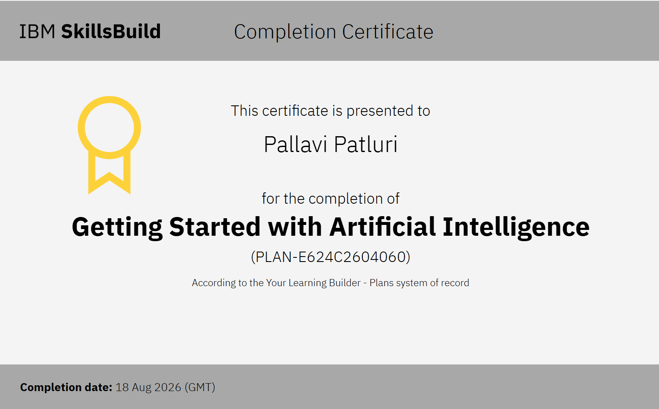
Certificates Earned

Slide 22
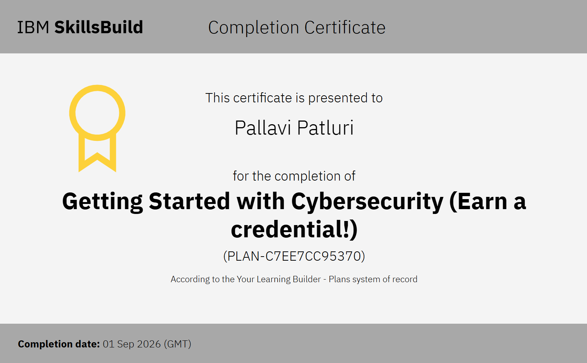
Certificates Earned

Slide 23
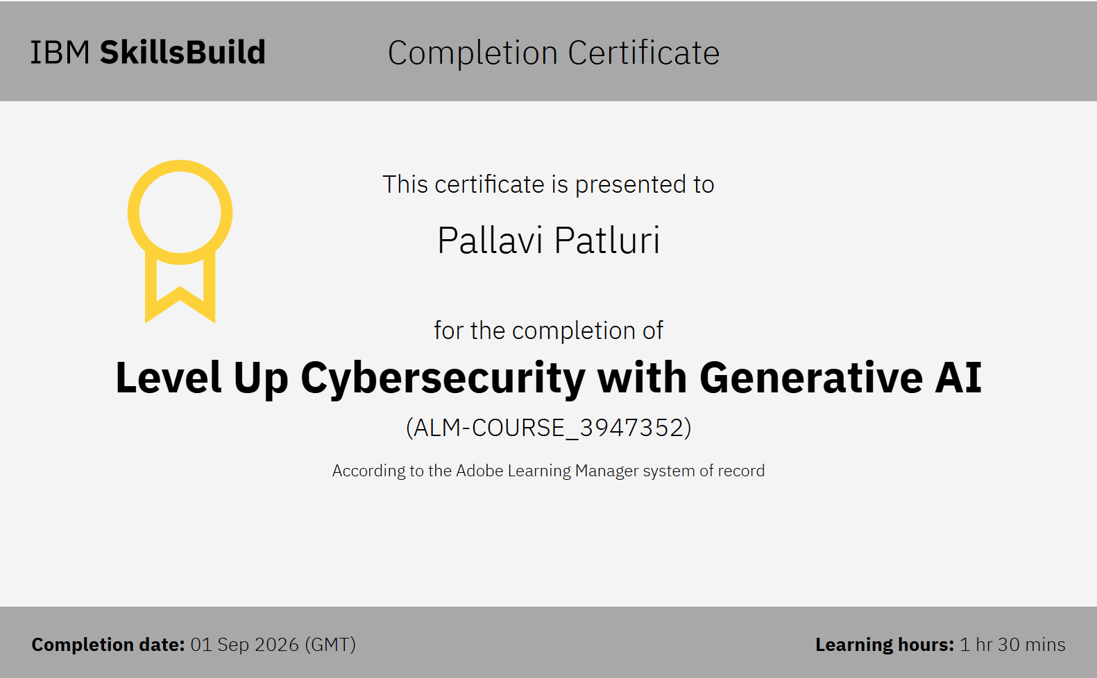
Certificates Earned

Slide 24
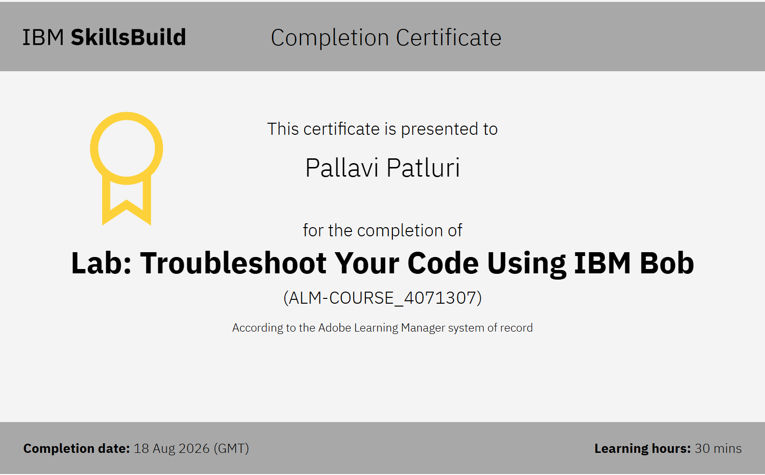
Certificates Earned

Slide 25


